Slide 1
Encountering the Poor
St. Maria of Paris as a practical role model

Slide 2
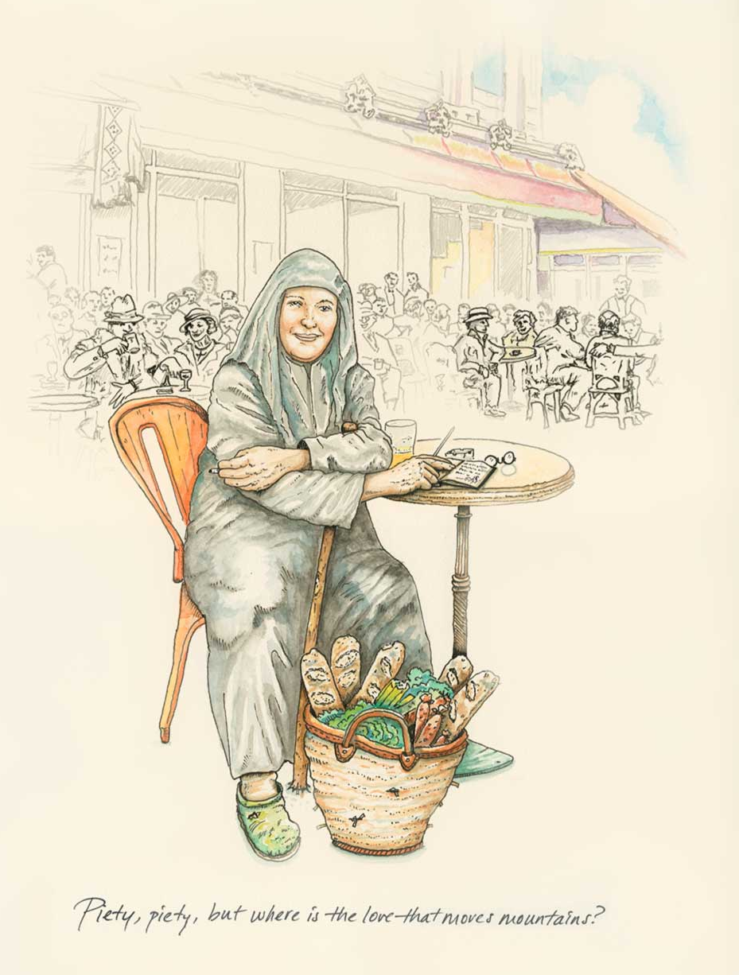
St. Maria Skobtsova

Slide 3
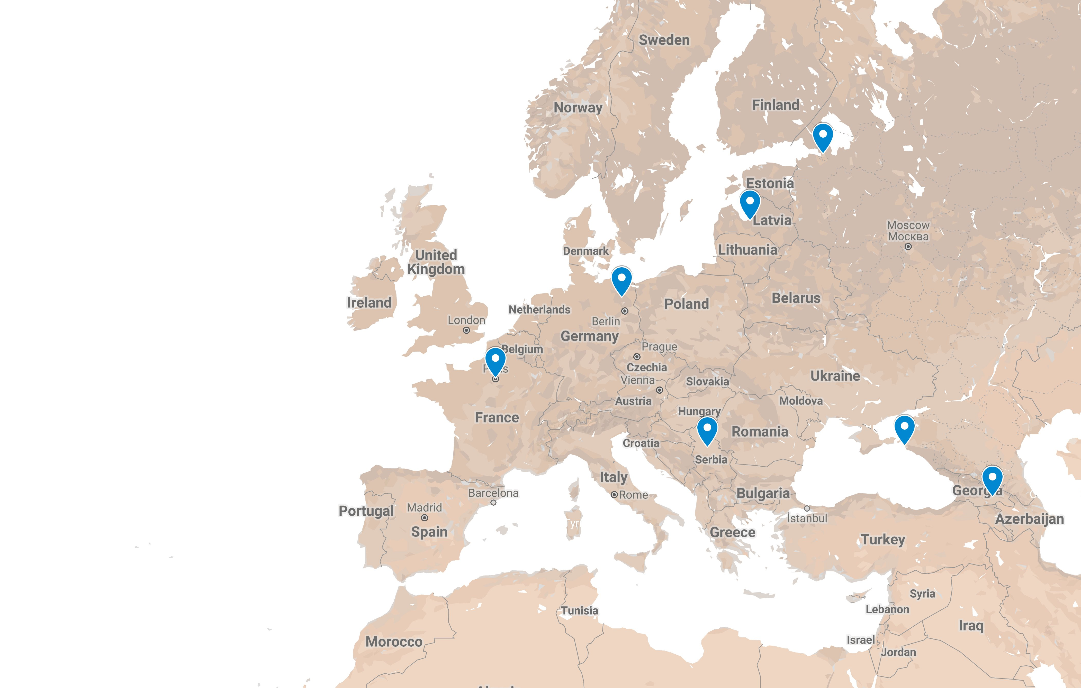
Born
Elizaveta Pilenko
Riga, Latvia,1891
Martyred
Ravensbrück Camp
Holy Saturday 1945
Radical, Poet, mother
St. Petersberg
Russia, 1906—1913
“Monasticism in the world”
77 rue de Lourmel
Paris, 1932—1943
Elected & Arrested
Anapa
Russia, 1918
Birth of Anastasia
Yugoslavia,1921
Birth of Yura
Tbilisi
Georgia, 1920

Slide 4
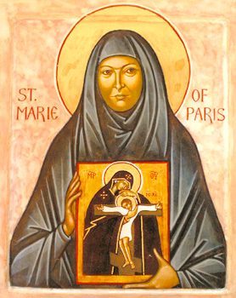
“[S]he went to the steel foundry in Creusot, where a large number of Russian [refugees] were working. She came there and announced that she was preparing to give a series of lectures on Dostoevsky. She was met with general howling: "We do not need Dostoevsky. We need linen ironed, we need our rooms cleaned, we need our clothes mended -- and you bring us Dostoevsky!" And she answered: "Fine, if that is needed, let us leave Dostoevsky alone." And for several days she cleaned rooms, sewed, mended, ironed, cleaned. When she had finished doing all that, they asked her to talk about Dostoevsky. This made a big impression on me, because she did not say: "I did not come here to iron for you or clean your rooms. Can you not do that yourselves?" She responded immediately and in this way she won the hearts and minds of the people.”
— Metropolitan Anthony Bloom recalls a friend’s story about St. Maria during her work with the Russian Student Christian Movement

Slide 5
“She exercised an enormous influence on us all. No matter what our nationality, age, political convictions — this had no significance whatever. Mother Maria was adored by all. The younger prisoners gained particularly from her concern. She took us under her wing. We were cut off from our families, and somehow she provided us with a family.”
— Rosane Lascroux, fellow prisoner at Ravensbrück
“It is very possible that [Mother Maria] took the place of a frantic companion. It would have been entirely in keeping with her generous life. In any case she offered herself consciously to the holocaust ... thus assisting each one of us to accept the cross .... She radiated the peace of God and communicated it to us.”
— Jacqueline Pery, fellow prisoner at Ravensbrück

Slide 6
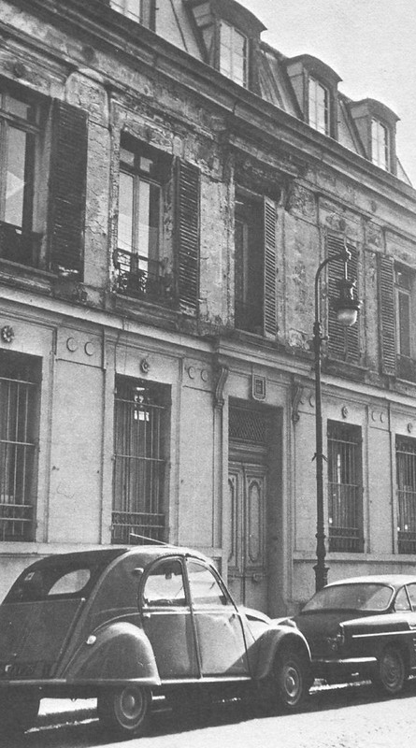
“I would say that we should not give away a single piece of bread unless the recipient means something as a person for us.”

Slide 7
Sources
Biographical information from Jim Forest’s introduction to Mother Maria Skobtsova: Essential Writings
Photos and icons from Jim Forest’s collection “Saint Maria Skobtsova of Paris and her community” on flickr
Watercolor by Jason Landsel, published by Plough
St. Maria and her community at 77 rue de Lourmel

